Slide 1
Neo4j Graph Database

Slide 2
Project Architecture
The data are downloaded as requested.
The project is based on a python file ‘neodatafix’, which processes and clears out the data, transforms the files, and imports the files.
There is another python file ‘neodataimport’ gets the resulted data, and imports them to neo4j
All rest queries are directly run through the web browser, on local connection with neo4j, to take advantage of the tools and the graphics it offers - as well as have a performance measurement with no additional effort

Slide 3
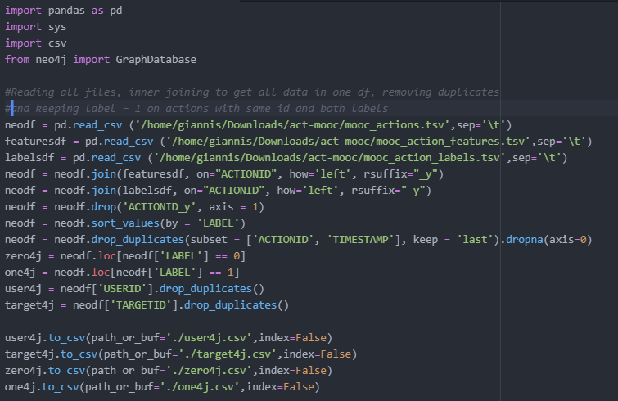
Neodatafix
Neodatafix merges data to a single df, removes identical duplicates, and keeps actions with label=1, when the same action exists with the two labels (keeping second after sorting in ascending order).
After that, we split files to users, targets, zero actions and one actions. The reasons will be later on discussed
We save our files to the current directory, and not on redis import folder. Writing in the import file requires admin privileges. However, our installed packages are for current user, so calling the script with sudo would result in errors. As such, manual copy of the files to the import folder is assumed at this point.
For linux, it is var/lib/neo4j/import

Slide 4
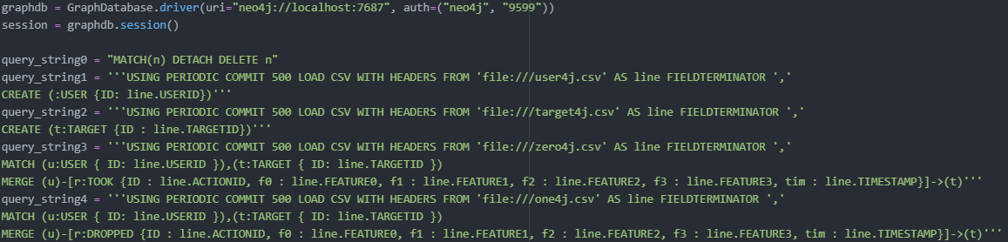
Neodataimport - query prep
We use the official neo4j python package.We import nodes first, and then relationships. We use periodic commit for increased performnce
The reasons for file splitting:
Target nodes are so little compared to the total, where it would be too resource intensive to search for their distinct values each time during data import, even with a constraint on their column
By splitting our actions, we dismiss our need for parametric relationship label. Since we have only two labels - and our dataset size allows it, that sounds smart. In any other case, we’d need to invoke APEC, which would complicate the queries syntax (although highly efficient)

Slide 5
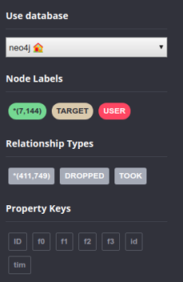
Neo4j - Graph stats & Depiction
We see everything we would expect. The numbers add up both in nodes and relationships, both kinds of nodes and relationships, as well as all the expected features.
NOTE: We did not proceed to change the ID of the nodes from Neo4j (although it is somehow feasible), since it was highly advised against by the community in many discussions. Instead, we created our own ID property

Slide 6
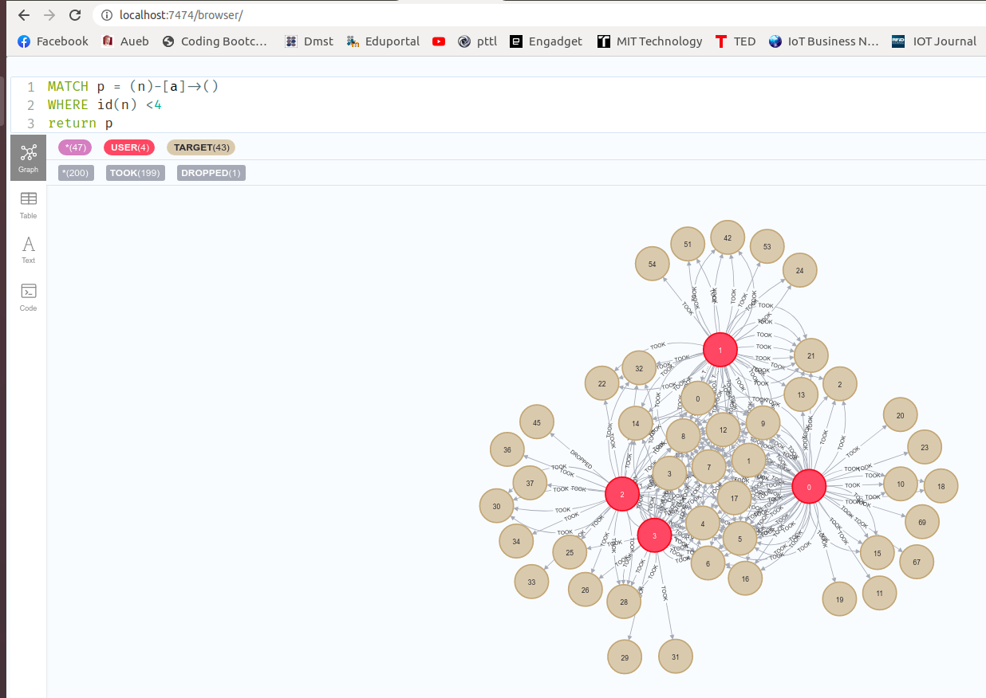
Neo4j - Graph depiction
We get a screenshot of our graph. We depict the first 4 users, along with the MOOCs they took, and the ones they dropped
Attention: The names of the relationships were used to give meaning, as well as work-arounds for issues created, when using int as a label.

Slide 7
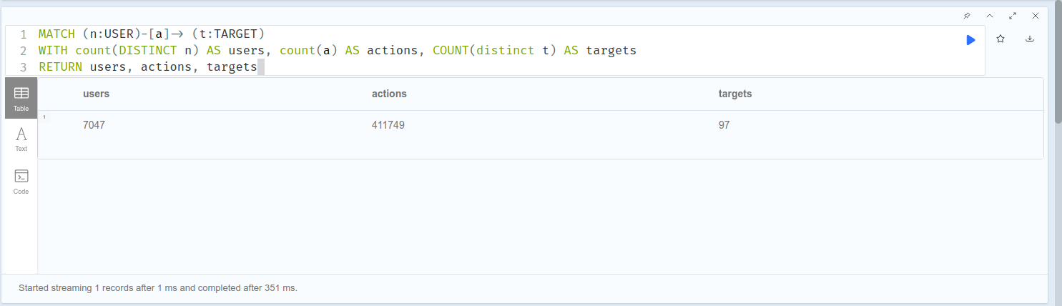
Neo4j - Sum of elements

Slide 8
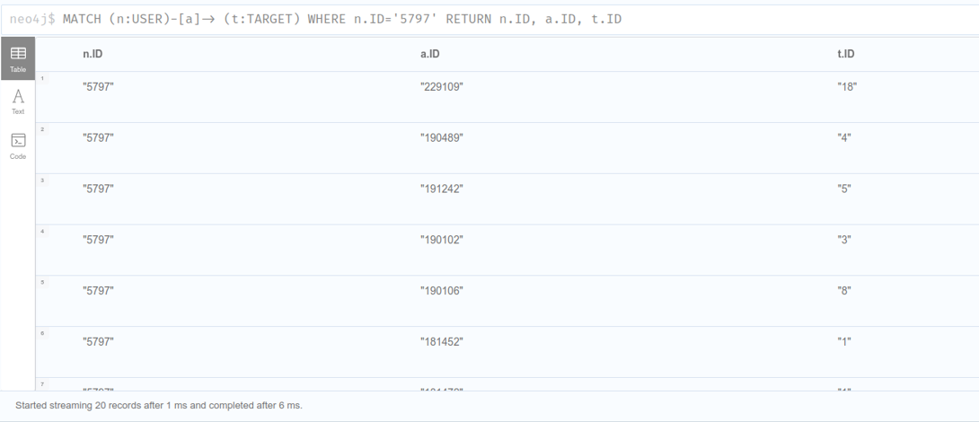
Neo4j - List of actions & targets for specific user

Slide 9
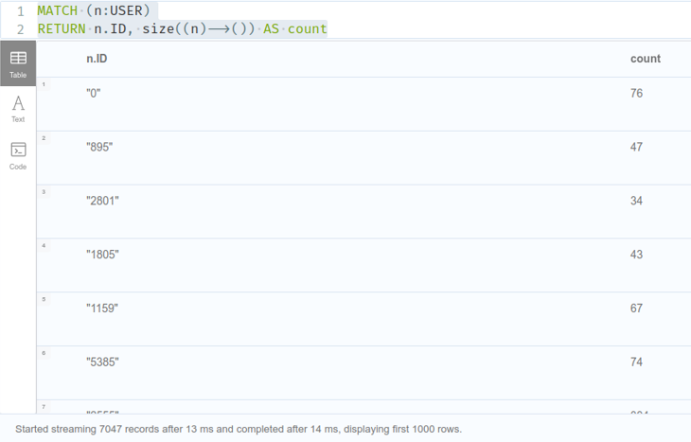
Neo4j - Actions per User
By taking advantage of the “placeholder” nature of n within the match command, and the property of size, we get away with not explicitly using loop structures, such as foreach and unwind

Slide 10
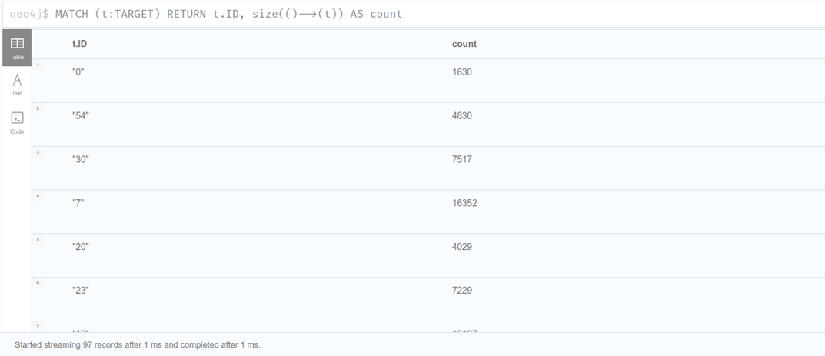
Neo4j - Actions per Target

Slide 11
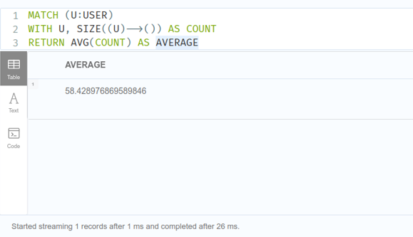
Neo4j - Avg actions per User

Slide 12
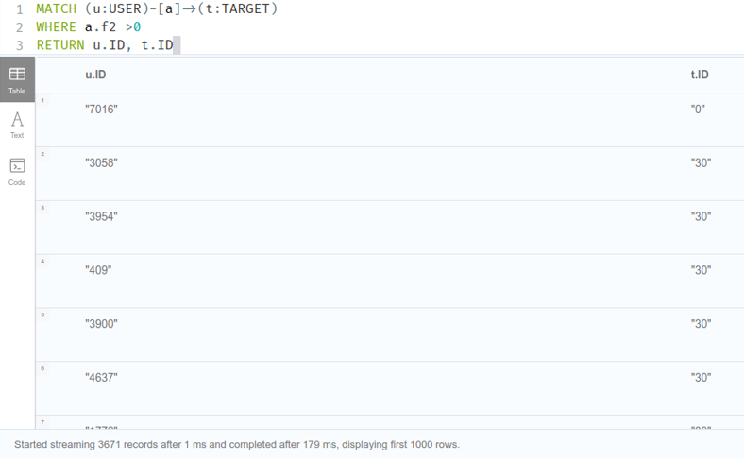
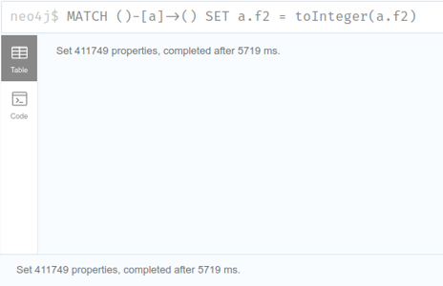
Neo4j - User & Target of actions with feature2 >0
We proceed to turn f2 to int before running our actual query. There is no need to do this for the rest of our features, since we don’t do anything with them in our scope

Slide 13
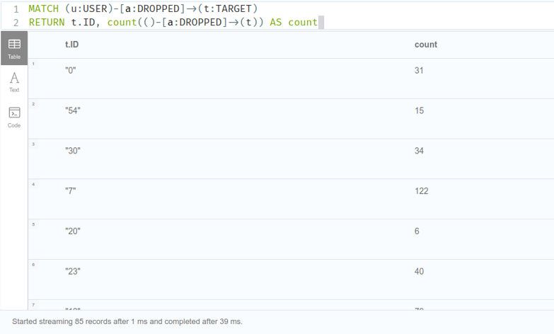
Neo4j - User & Target of actions with feature2 >0

Slide 14
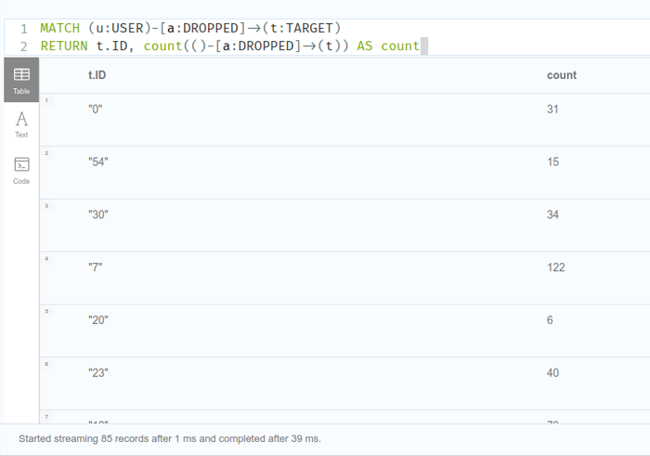
Neo4j - Count of Users dropped per MOOC

Slide 15
Neo4j - Get in touch with the code
The code is also available through this link

